Slide 1
JPA(Java Persistence API )

Slide 2
Objectives
Introduction to the java persistence API
JPA entity class basics
JPA Architecture
JPA - Obtaining a JPA Database Connection
Configure JPA with Hibernate Example
JPA Web Application demo
<number>/14

Slide 3
JPA - Introduction
a Java EE/Jakarta EE specification for managing relational data in Java.
a standard for ORM (Object-Relational Mapping), which automatically converts data between Java objects (POJOs) and database tables.
JPA allows developers to work with objects instead of SQL statements, with the implementation typically called a persistence provider.
Popular implementations of JPA include: Hibernate (most popular)EclipseLink (official RI of JPA)Apache OpenJPA

Slide 4
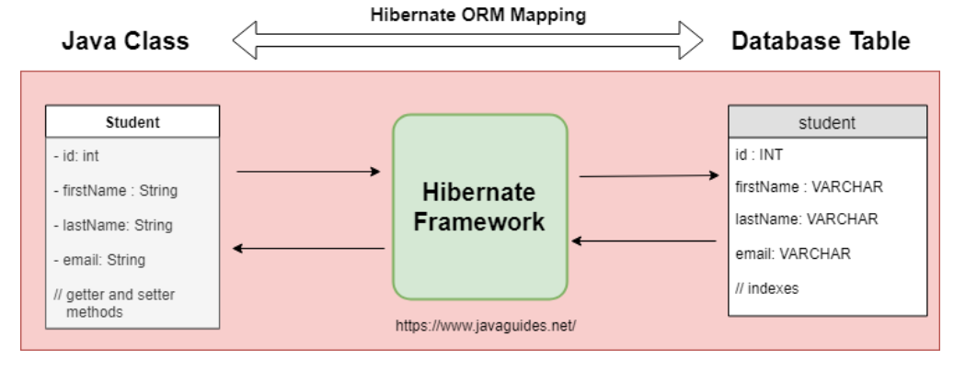
Hibernate ORM mapping

Slide 5
Why use JPA?
Reduce manual JDBC code: No need to write manual SQL for CRUD (Create, Read, Update, Delete).
Easy to maintain, extend: Manage relationships between entities using annotations instead of SQL.
Good integration with Java EE, Spring Boot: Easy to integrate with popular frameworks.
Support cache and high performance: Has a cache mechanism to help query faster.

Slide 6
JPA Entity Class Basics
Defining a JPA Entity Class
  A JPA Entity Class is a Java class that is mapped to a table in a relational database.
  Each object of this class corresponds to a row in the table.
Requirements for Entity Classes
  Must have @Entity annotation → Marks this as an entity.
  Must have parameterless constructor → JPA requires to create object from database.Must not declare final → So that JPA can extend or proxy the object.
  If transmitted over network (detached object) → Must implement Serializable.
<number>/14

Slide 7
JPA Entity Class Basics
Persistent Fields and Properties in Entity Classes
  Should be declared as private, protected or package-private.Accessed via getter/setter.
Persistent Fields
  Getter/setter methods can be used to map data.
  JPA uses the JavaBeans naming convention to map these methods.
<number>/14

Slide 8
JPA Entity Class Basics
Persistent Properties
  Using @Entity, @Id, @GeneratedValue, and
  @Column annotations for mapping between Java object to database table columns.
Primary Keys in Entities
  Use @Id to mark primary keys.
  Can use @GeneratedValue to generate values ​​automatically.
Relationship Mapping:
  One-to-One (@OneToOne)
  One-to-Many (@OneToMany)
  Many-to-One (@ManyToOne)
  Many-to-Many (@ManyToMany)
<number>/14

Slide 9
JPA - Architecture
Class Level Architecture
JPA Class Relationships
JPA Simple Example
Usage of EntityManager, EntityManagerFactory and EntityTransaction
<number>/14

Slide 10
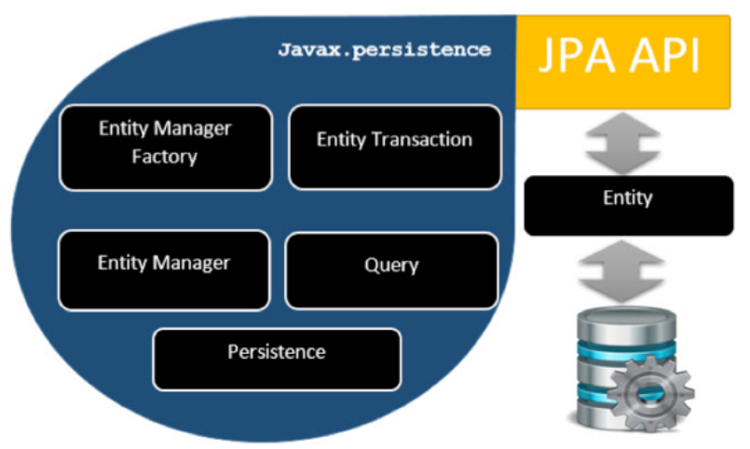
JPA - Architecture
Class Level Architecture
<number>/14

Slide 11
JPA - Architecture
EntityManagerFactory - This is a factory class of EntityManager. It creates and manages multiple EntityManager instances.
EntityManager - It is an Interface, it manages the persistence operations on objects. It works like a factory for Query instance.
Entity - Entities are the persistence objects, stored as records in the database.
EntityTransaction - It has one-to-one relationship with EntityManager. For each EntityManager, operations are maintained by EntityTransaction class.
Persistence - This class contains static methods to obtain EntityManagerFactory instance.
Query - This interface is implemented by each JPA vendor to obtain relational objects that meet the criteria.
<number>/14

Slide 12
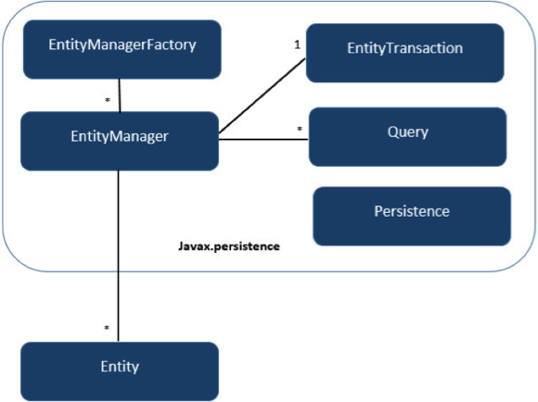
JPA - Architecture
JPA Class Relationships
<number>/14
<number>/14

Slide 13
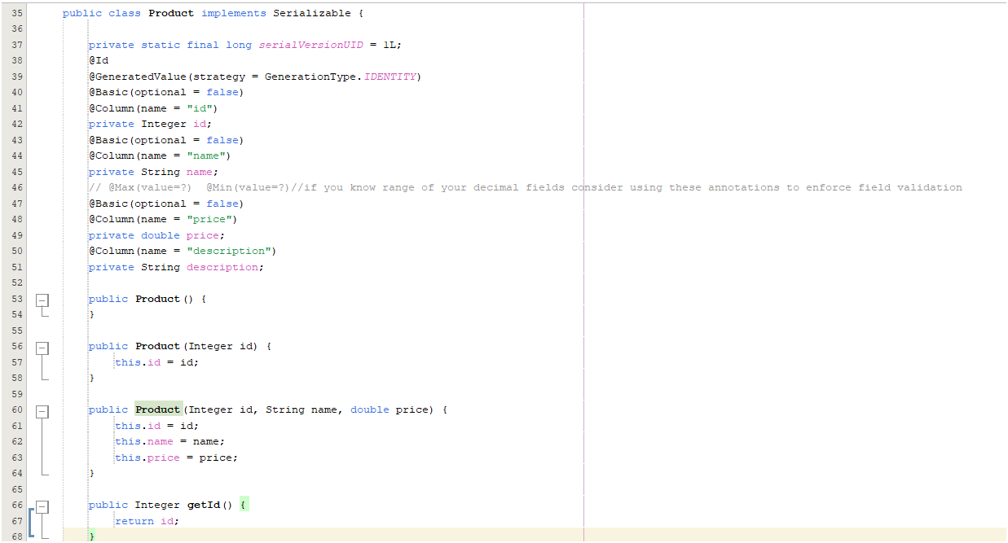
JPA Simple Example
<number>/14

Slide 14
JPA - Obtaining a JPA Database Connection
An EntityManager represents a database connection and enables database operations, with each HTTP request in a web app typically using a separate instance.
The EntityManagerFactory efficiently creates multiple EntityManager instances for a specific database.
Database modifications require an active transaction, managed by an EntityTransaction.
Additionally, an EntityManager serves as a factory for Query instances to execute database queries.
<number>/14

Slide 15
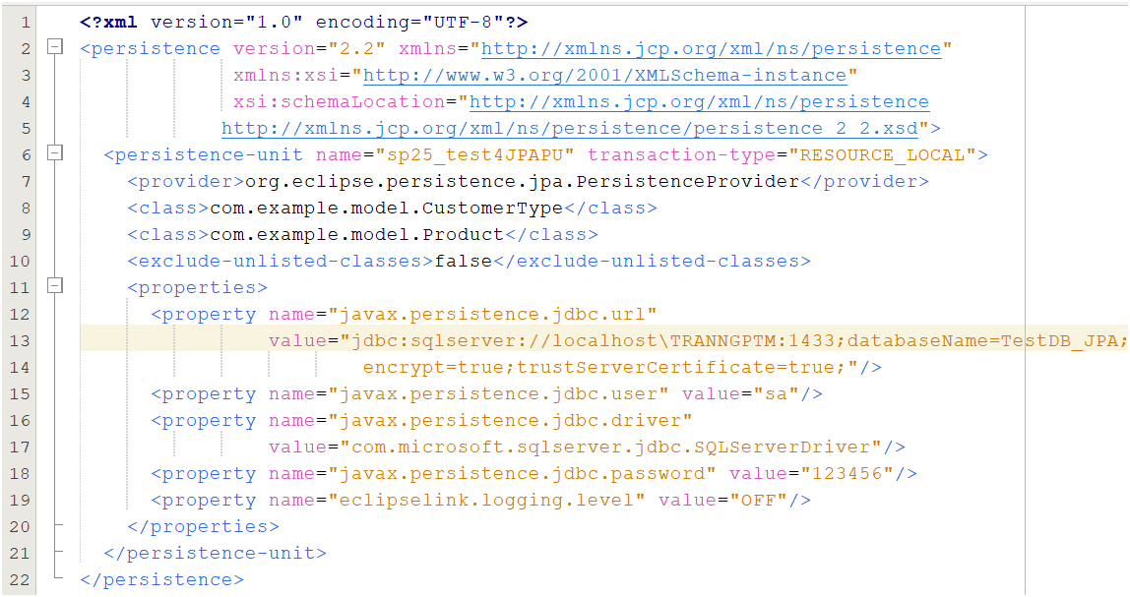
Definition of a persistence unit in an XML file
<number>/14

Slide 16
Definition of a persistence unit in an XML file
Suppose TestDB_JPA has Product table as follows:
CREATE TABLE [dbo].[Product](
[id] [int] IDENTITY(1,1) PRIMARY KEY NOT NULL,
[name] [nvarchar](255) NOT NULL,
[price] [decimal](10, 2) NOT NULL,
[description] [nvarchar](500) NULL)
<number>/14

Slide 17
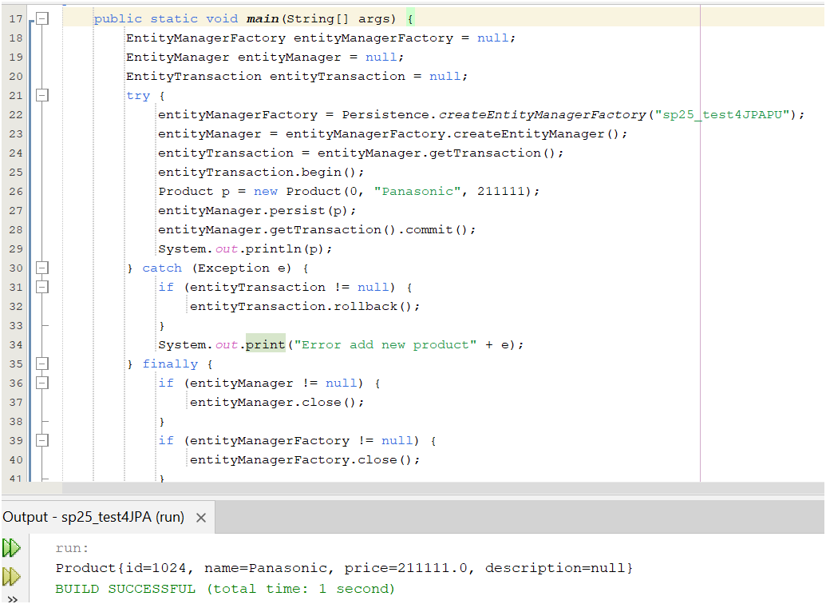
Usage of EntityManager, EntityManagerFactory and EntityTransaction
Note: Always use Transaction when performing CRUD to ensure data integrity, if the query is read-only (SELECT) in Hibernate using EntityManager or Session.
<number>/14

Slide 18
JPA Web Application demo
Create an java with Ant Web Project
Add library
Project Structure
SQL server Database Setup
Create a JPA entity - Product.java
Hibernate Java-based configuration
Create a ProductDAO.java
Create s ProductService.java
Create a ProductServlet.java
Creating Product Listing JSP Page - product-list.jsp
Creating Error JSP page
Deploying and Testing the Application Demo

Slide 19
Summary
Java persistence API
JPA entity class basics
JPA Architecture
JPA - Obtaining a JPA Database Connection
Configure JPA with Hibernate Example
JPA Web Application demo
<number>/14

